Slide 1
Properties of
Regular Languages

Slide 2




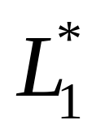
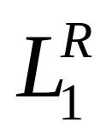


For regular languages and
we will prove that:
Union:
Concatenation:
Are regular
Languages
Star:
Reversal:
Complement:
Intersection:

Slide 3
We say Regular languages are closed under
Union:
Concatenation:
Star:
Reversal:
Complement:
Intersection:

Slide 4




A useful transformation: use one accept state
NFA
2 accept states
Equivalent
NFA
1 accept state

Slide 5


In General
NFA
Equivalent NFA
Single
accepting
state

Slide 6
Extreme case
NFA without accepting state
Add an accepting state
without transitions

Slide 7
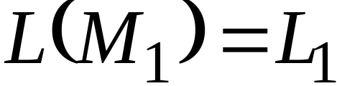
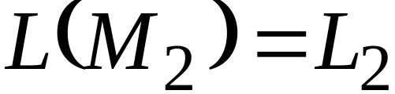


Take two languages
Regular language
Regular language
NFA
NFA
Single accepting state
Single accepting state

Slide 8

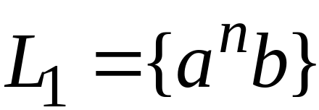
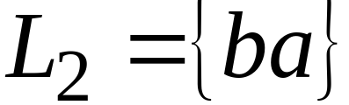
Example

Slide 9

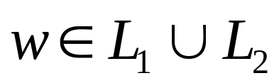
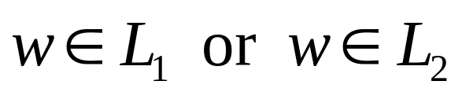
Union
NFA for

Slide 10
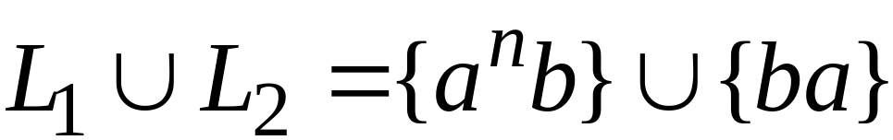
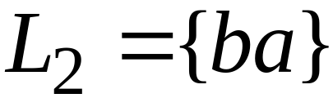
Example
NFA for

Slide 11

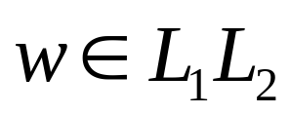
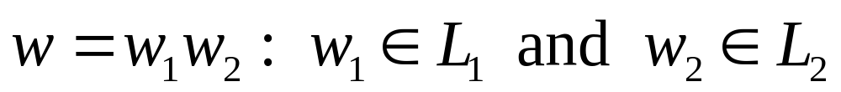
Concatenation
NFA for
change to
regular state

Slide 12
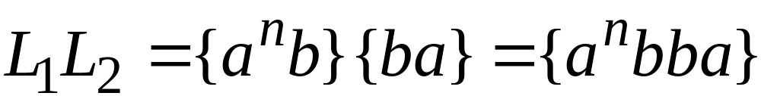

Example
NFA for

Slide 13
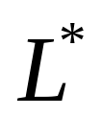




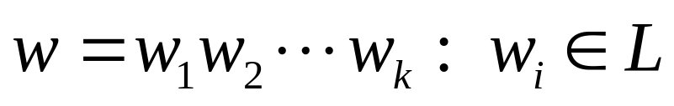
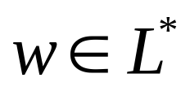

Star Operation
NFA for
change to
regular state
or

Slide 14
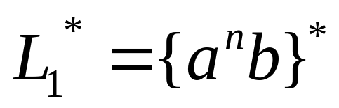


Example
NFA for

Slide 15
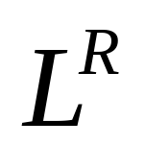




Reverse
NFA for
1. Reverse all transitions
2. Make the initial state accept state
and the accept state initial state

Slide 16
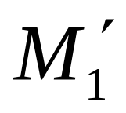
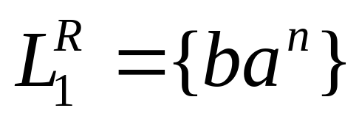
Example

Slide 17
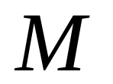
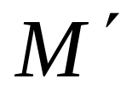
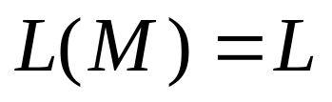
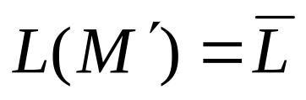

Complement
1. Take the DFA that accepts
2. Make accept states regular
and vice-versa

Slide 18

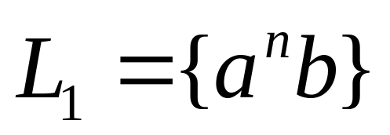
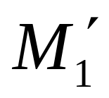
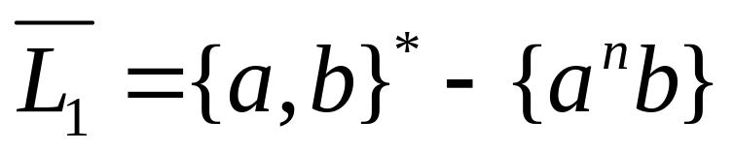
Example

Slide 19
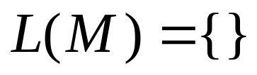
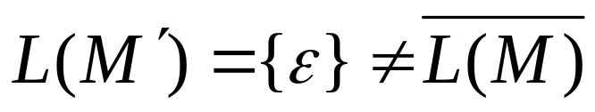
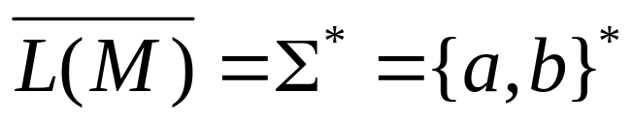
NFAs cannot be used for complement
Make accept states regular
and vice-versa
NFA
NFA
it is not the
complement

Slide 20
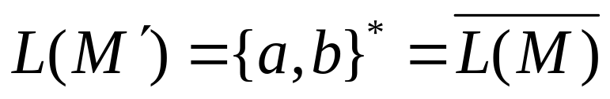
Same example with DFAs
Make accept states regular
and vice-versa
DFA
DFA
it is the
complement

Slide 21
Intersection
regular
we show
regular
regular

Slide 22




DeMorgan’s Law:
regular, regular
regular, regular
regular
regular
regular

Slide 23
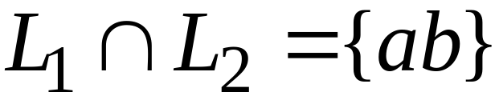
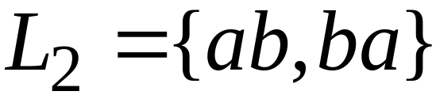
Example
regular
regular
regular

Slide 24

Another Proof for Intersection Closure
Machine
Machine
DFA
for
DFA
for
Construct a new DFA that accepts
simulates in parallel and

Slide 25

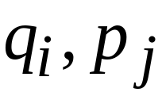
States in
State in
State in

Slide 26




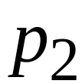
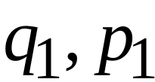
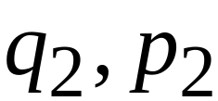
DFA
DFA
transition
transition
DFA
New transition

Slide 27

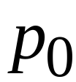
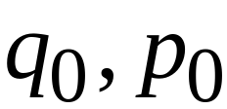
DFA
DFA
initial state
initial state
DFA
New initial state

Slide 28



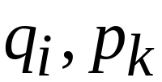
DFA
DFA
accept state
accept states
DFA
New accept states
Both constituents must be accepting states

Slide 29

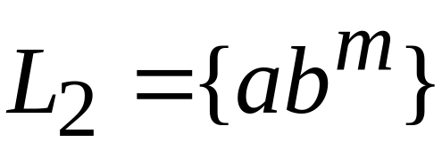








Example:

Slide 30

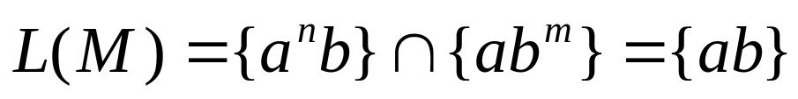







DFA for intersection

Slide 31
Construction procedure for intersection
1. Build Initial State
2. For each new state and for each symbol
add transition to either an existing state
or create a new state and point to it
3. Repeat step 2 until no new states
are added
4. Designate accept states

Slide 32
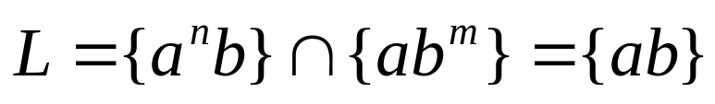
Automaton for intersection
initial state

Slide 33






Automaton for intersection
add transition and new state
for symbol a

Slide 34





Automaton for intersection
add transition and new state
for symbol b

Slide 35
Automaton for intersection
Repeat until no new states can be added

Slide 36




Automaton for intersection
accept state for
accept state for
add Accept state

Slide 37


Intersection DFA :
simulates in parallel and
accepts string
if and only if:
accepts string
and accepts string

